Slide 1
Chemistry – Jan 15, 2020
P3 Challenge-
Write the complete electron configuration of Aluminum.
Today’s Objective –
Atomic model game activity
Get out Electron Configurations WS for HMK check

Slide 2
Chemistry – Dec 5, 2018
Objective –
Atomic Structure
Agenda
Homework Review
More about Electron Configurations
Atomic Model Game Instruction
Assignment: Read the Atomic Structure Game Instructions: Game Play

Slide 3
Writing Electron Configurations
List the subshells in the order they are filled.
Place an exponent to represent the number of electrons filling that subshell.
BEWARE: The maximum exponents possible are:
s², p⁶, d ¹⁰, and f ¹⁴

Slide 4
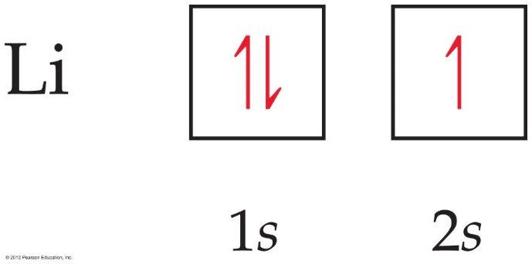
Orbital Diagrams
Each box in the diagram represents one orbital.
Half-arrows represent the electrons. (You may also use full arrows.)
The direction of the arrow represents the relative spin of the electron.
When drawn by hand, often the orbitals are represented by a blank line with the orbital label below and the arrow electrons above.

Slide 5
Some Examples
Hydrogen, H Z=1 1s¹
Helium, He Z=2 1s²
Lithium, Li Z=3 1s²2s¹
Beryllium, Be Z=4 1s²2s²
Boron, B Z=5 1s²2s²2p¹
Carbon, C Z=6 1s²2s²2p²
Nitrogen, N Z=7 1s²2s²2p³
Oxygen, O Z=8 1s²2s²2p⁴
Fluorine, F Z=9 1s²2s²2p⁵
Neon, Ne Z=10 1s²2s²2p⁶

Slide 6
More Examples
Sodium, Na Z=11 1s²2s²2p⁶3s¹
Magnesium, Mg Z=12 1s²2s²2p⁶3s²
Aluminum, Al Z=13 1s²2s²2p⁶3s²3p¹
Silicon, Si Z=14 1s²2s²2p⁶3s²3p²
Phosphorus, P Z=15 1s²2s²2p⁶3s²3p³
Sulfur, S Z=16 1s²2s²2p⁶3s²3p⁴
Chlorine, Cl Z=17 1s²2s²2p⁶3s²3p⁵
Argon, Ar Z=18 1s²2s²2p⁶3s²3p⁶
Potassium, K Z=19 1s²2s²2p⁶3s²3p⁶4s¹
Calcium, Ca Z=20 1s²2s²2p⁶3s²3p⁶4s²

Slide 7
Large Z Elements: Noble Gas Configuration
Arsenic, As Z=33
1s²2s²2p⁶3s²3p⁶4s²3d¹⁰4p³
Silver, Ag Z=47
1s²2s²2p⁶3s²3p⁶4s²3d¹⁰4p⁶5s²4d ⁹
Or…[Kr]5s²4d ⁹ Abbreviated Electron configuration.
Radon, Rn Z=86
1s²2s²2p⁶3s²3p⁶4s²3d¹⁰4p⁶5s²4d¹⁰5p⁶6s²4f¹⁴5d¹⁰6p⁶
Or…[Xe] 6s²4f¹⁴5d¹⁰6p⁶

Slide 8
Using the highest energy electron
Because the order of filling is always the same, the only real question when writing electron configurations is when do you stop?
Note the electron configuration for the highest energy electron.
Write the electron configuration energy filling order until you reach that last term.

Slide 9
Elements in the same Group
Hydrogen, H Z=1 1s¹
Lithium, Li Z=3 1s²2s¹
Sodium, Na Z=11 1s²2s²2p⁶3s¹
Potassium, K Z=19 [Ar]4s¹
Rubidium, Rb Z=37 [Kr]5s¹
Cesium, Cs Z=55 [Xe]6s¹
Francium, Fr Z=87 [Rn]7s¹
Elements in the same group have the same outer electron configuration. In general: ns¹
This explains the common reactivity and properties in a group!!

Slide 10
Ion electron configurations
The electron configurations for ions add or subtract electrons in the regular Aufbau order.
Ex: Na = 1s² 2s² 2p⁶ 3s¹ Na⁺ = 1s² 2s² 2p⁶
Ex: O = 1s² 2s² 2p⁴ O⁻² = 1s² 2s² 2p⁶
The electronic configuration of isoelectronic ions will be the same.

Slide 11
Exit Slip - Homework
Exit Slip: Explain Hund’s Rule.
What’s Due? (Pending assignments to complete.)
Read Atomic Game Activity Instructions
What’s Next? (How to prepare for the next day)
Read Holt p84 - 88

